Slide 1
Action Plan Localisation of SDGs in Odisha

Slide 2
State Action Plan
Action Taken | Status | Decisions
MoPR initiatives on LSDGs | Yes | Core Committee formation at state level and one day core committee held under the chairmanship of Principal Secretary with members.
Expert Committee Report on LSDGs in Rural areas with PRIs | Done | Communicated to concerned departments by PR & DW and P & C Department
Joint Advisories/ Govt. Letters | In process | Joint letters will be issued.
AKAM | Yes
Thematic Priorities | Done | By each Gram Panchayats through Special Gram Sabha SANKALP
Sankalp | Done | Resolution by each Gram Panchayats on 24th April 2022.

Slide 3
Important Circulars
State Level Steering Committee Core Committee for LSDGs | Chaired by Development Commissioner and other Departmental Secretaries | Letter Link
PR & DW Deptt. Core committee | Chaired by Principal Secrteary PR & DW Department along with Directors, Special Secretaries and SDG Cell Officials | Letter Link
One day Orientation on SDG/ LSDGs to PR & DW Department Officials | Chaired by Principal Secretary, Directors, SPl Secretaries, Senior Officials and SDG Cell Officials of PR & DW Deprt. | Letter Link
Sankalp/ AKAM | Issued Instruction to conduct Special Gram Sabh (PR & DW Department) | Letter Link

Slide 4
MoPR Initiatives on LSDGs:
Activities | Status | Decisions
Formation of State Steering Committee at Department level | Formed | A committee under the Chairmanship of Chief Secretary with other Secretary. (Govt Letter ) A Core committee under the Chairmanship of Principal Secretary with concerned Directors, Special Secretaries and Officials of SDG Cell of PR & DW Dept. (Govt Letter)
Identification of Nodal Officers at State District Block GP | Done Done Done Not Done (In process) | PD at District BDO at Block Panchayat Executive Officer/ GRS or Extension Officers will be nominated as Nodal Officer.
Instructions/Advisories by different line departments down the line | Instructions issued to all Districts/ Blocks on SDGs | The guideline on SoP relating to different thematic goal already issued by P & C as well as PR & DW Deptt. (Govt Letter)

Slide 5
Preparation of GPDP/BPDP/DPDP
Activities | Status | Decisions
Convergent Planning, implementation and monitoring at Panchayat level. Accordingly capturing resource envelope of these schemes in the GPDP, BPDP and DPDP | Convergent planning limited to 2 or 3 schemes under GPDP, BPDP & DPDP (Intra- Deptt, not Inter-Deptts) Limited Resource Envelop | Convergence meeting with different line departments to ensure convergence of funds / programmes under GPDP/BPDP/DPDP in addressing issues. To set up GP/ Block / District level targets with measurable indicators having convergence possibilities and resource mobilization. Identifying Nodal Officers of Line Deptts and coordination

Slide 6
Preparation of GPDP/BPDP/DPDP contd…
Activities | Status | Decisions
Clearly laying out Physical and Financial targets in these planning | The Physical & Financial Targets under GPDP / BPDP / DPDP are not based on situational report, sourced from Situational Analysis Report, MA Survey, VRP Survey etc. | Concerned Line Deptts are to attend the meetings of GPDP, BPDP & DPDP at the respective levels for wider consultation for working out physical & financial target through common resource envelop. (Whole of Govt. Approach).
Involvement of different stakeholders including NGOs, INGOs, domain experts | Is under process. | Whole of Society Approach be put in place prior to finalization of Panchayat Development Plan involving all Stakeholders.

Slide 7
Indicator Framework and Documentation
Planning & Convergence Department declared as Nodal Department to monitor progress SDGs in the State.
Odisha SDG Indicator Framework (2019) with 367 indicators– To track the progress of SDGs in the State
Currently, OSIF Version 2.0 has been prepared with 292 indicators

Slide 8
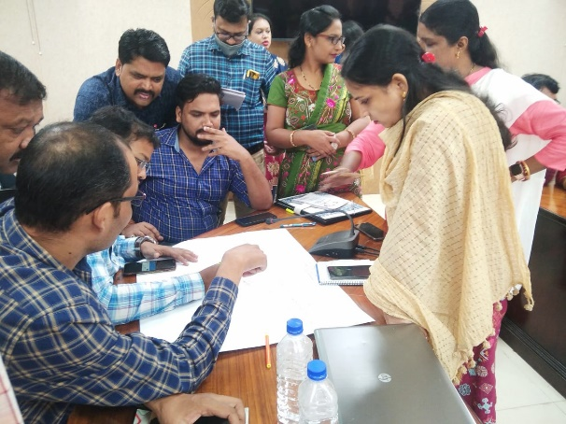
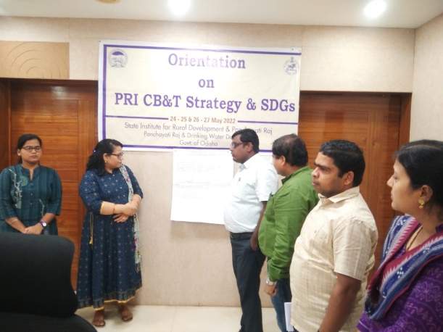
Capacity Building
PDs/ADMs from each District participated one day workshop conducted by P&C Department under the chairmanship of Development Commissioner
Addl PD (Admn), District Panchayat Officers, Asst. Project Directors and District Project Managers(RGSA participated two days Orientation workshop conducted by SIRD&PR.) – (Two Batch 51+59=110)

Slide 9
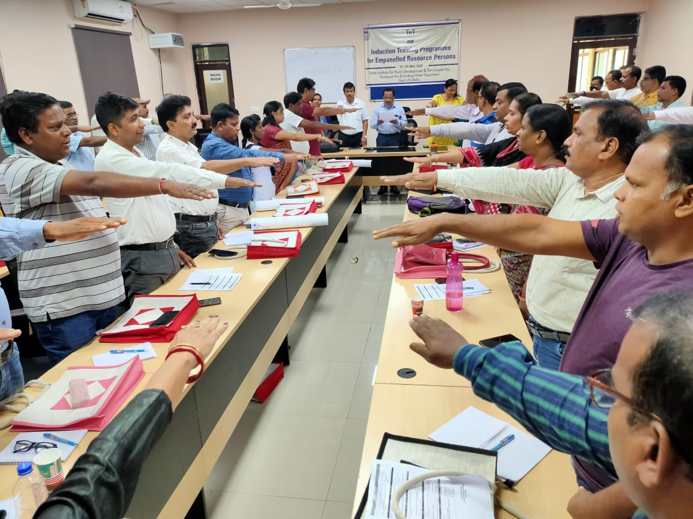
Capacity Building
Addl. PD, District Panchayat Officer, Asst. Project Director (Trg),DPM(RGSA) (40 officers has been nominated as Master Trainer for 9 thematic areas.
Mentoring 9 themes - 5 Gram Panchayts has been assigned to each Instructors / Faculties of SIRD&PR, ETC, DPRC also APD(Trg) & DPM(RGSA).

Slide 10
Capacity Building 2022-2023
PRI Level | Duration | Total Number of Participants
ZP | One Day | 853
Block | One Day | 6793
Gram Panchayat | One Day | 6794
Total |  | 14440
Ward Members | One Day | 91913
Grand Total | - | 106353
Mode of Training : Physical as well as Virtual Model

Slide 11
Mapping Role of PRIs in CSS:
Activities | Status | Decisions
Mapping Central Govt and State Schemes to different Themes and related SDGs | For State Level P& C Dept. For RLBs PR & DW Dept. | State Team (SPMU) already working on under OSIF 2.0 the Mapping of activities & so also PR & DW for RLBs
Implementation Strategies to translate into actions at the Panchayat level | Capacity Building & Training taken up by SIRD&PR as well as P&C Deptt. Govt. of Odisha. | The revamped RGSA has provisioned CB & T along with training for Elected Representatives. Constitution of SDG cell in DRDAs and Blocks. Quarterly Monitoring of progress on thematic SDGs at respective levels

Slide 12
Data Collection System
Activities | Status | Decisions
Capturing Data for various local indicators on Quarterly basis | An indicative data capture framework proposed in the Expert Group Report. | Constitution of monitoring committee and Capturing of data after finalization of indicators may be worked out by PR & DW Deptt at respective Scheme Officer level.
Integration of monitoring parameters of different schemes into SDG Dashboard for monitoring | State PMU at P & C Deptt are working on it | Being developed at State level
Approach on different mechanisms of incentivization of Panchayats for excellence in localization of SDGs through attainment of different themes | Current State Panchayat incentive / award guidelines are being revised. Revamped RGSA has provisioned for such awards on best performance of 9 thematic goals at MoPR, GoI level from the year 2022-23 | The State incentive / award guidelines may be revised to accommodate such awards w.e.f 2022-23 Evaluation of performance based on achievements in indicators relating to thematic areas. Innovation practices to be documented / local champions to be honoured.

Slide 13
Your valued Feedback Please !!

